Slide 1

Hotel Aggregator Power BI Visulatiozation
Created by Mozadded Ul Islam
Internship Task by Mentorness

Slide 2
Table of Contents
Problem Statement 2. Project Objectives
3. Key Insights 4. Recommendations

Slide 3
Problem Statement
This projects aims to analyze a dataset of hotel aggregator listings using of Power BI. The dataset comprise various attributes related to listings, hosts, reviews, and availability. The objective is create comprehensive visualizations and insights that shed light on trends, patterns, and factors influencing the performance of listings.

Slide 4
Project Objectives
1. Visualize the distribution of listings on map to identify popular neighborhood.
2. Analyze pricing trends based on property types, room types, and accommodation capacity.
3. Evaluate Host Characteristics, including super host status, response times, and verification methods.
4. Review Scores and Guest Satisfaction and their impact on overall performance.
5. Analyze the property types and trends.

Slide 5
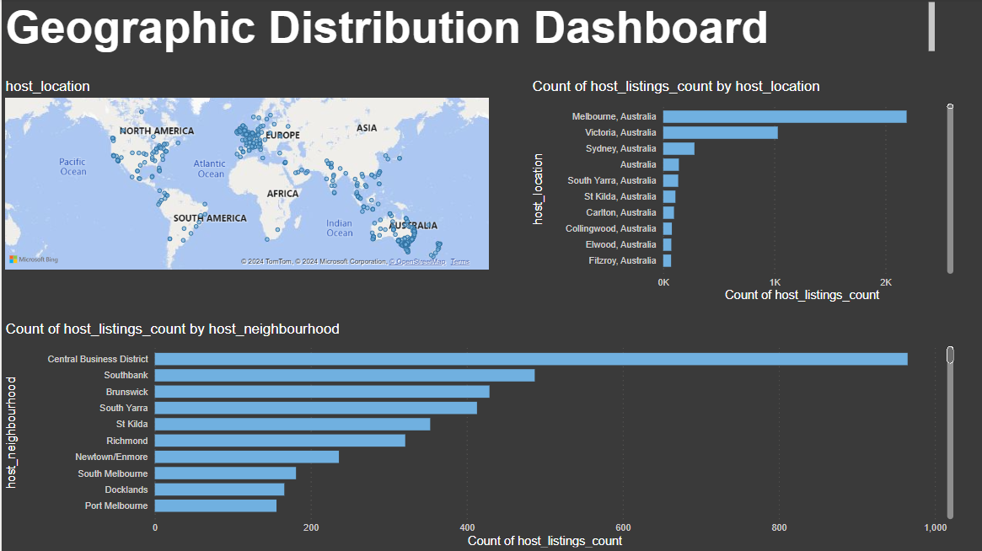

Slide 6
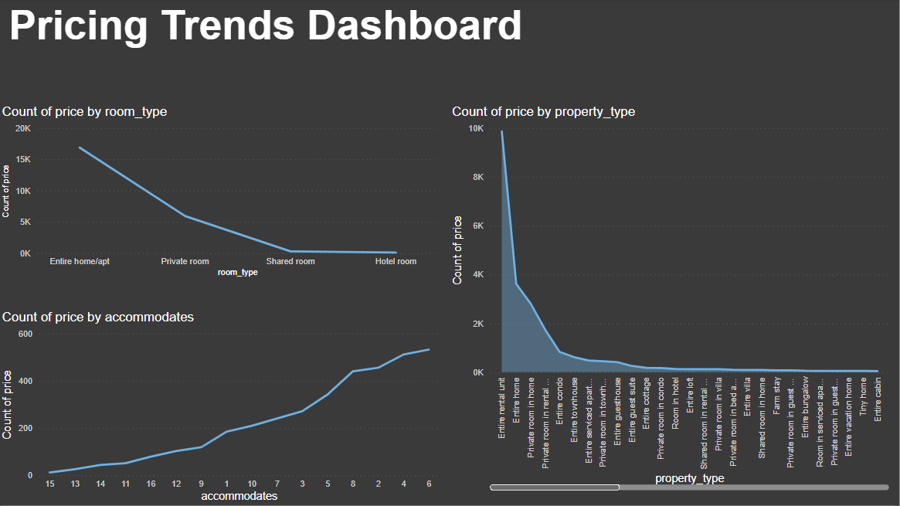

Slide 7
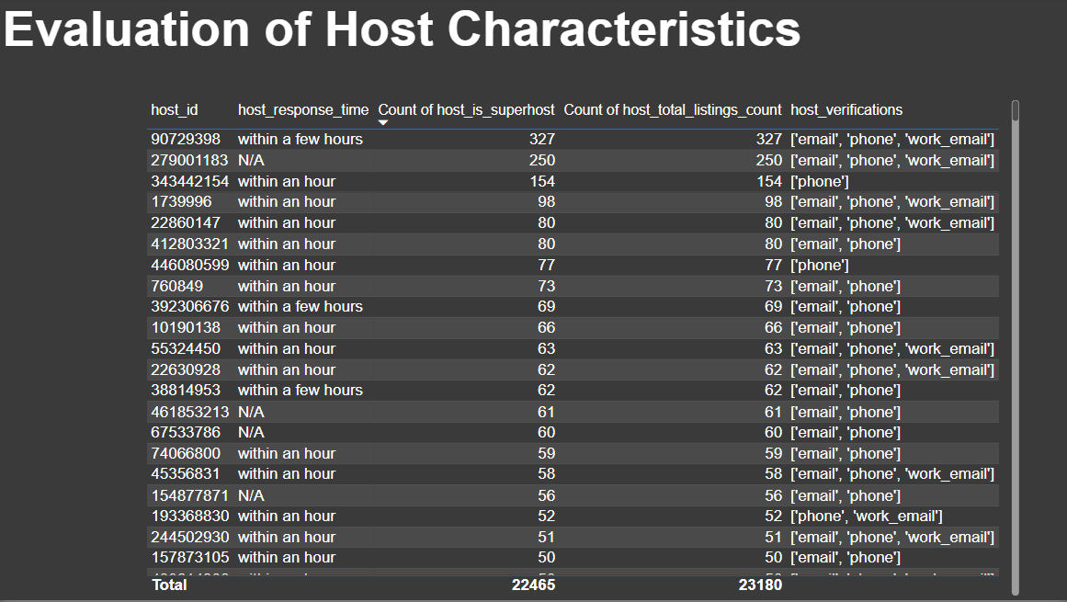

Slide 8
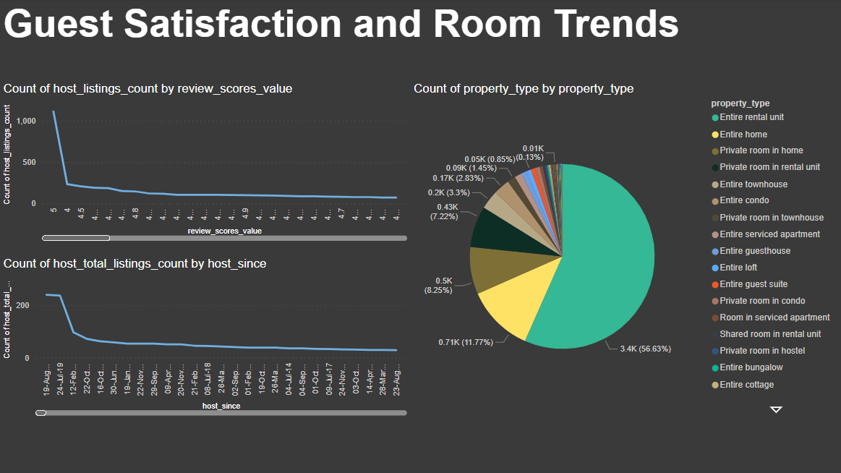

Slide 9
Key Insights
Geographical Insights provide about the distributions of listings in popular neighborhoods, host locations, concentration of areas and popularity among them.
Pricing and availability analysis showcased average pricing among the variety of room facilities.
Host performance demonstrates hosts’ methods and it’s results.
Review and guest satisfactions provides insights about the relationship between host listing counts and values among them.
Property type shows how many types are available.

Slide 10
Recommendation
Host Performance Optimization:
Encourage hosts to maintain quick response times to enhance guest satisfaction.
Promote the use of multiple verification methods to build trust with guests.
Consider the benefits of achieving super host status for improved credibility.
Pricing and Availability Strategies:
Analyze pricing trends for different property and room types to set competitive rates. Adjust pricing based on accommodates to maximize revenue and occupancy.
Monitor availability to capitalize on high-demand periods and adjust pricing accordingly.

Slide 11
Recommendation
Guest Satisfaction Enhancement:
Focus on improving review scores by providing exceptional service and amenities.
Track guest satisfaction levels over time to identify areas for improvement.
Tailor property and room offerings to meet guest preferences and enhance satisfaction.
Property and Room Type Management:
Understand the popularity of different property and room types to optimize inventory. Diversify offerings based on demand for specific accommodation options.
Utilize insights to enhance marketing strategies and target relevant customer segments.

Slide 12
THANK YOU

